Slide 1

Implementation of Rotation algorithm in Halide:
Fast Parallel Image Rotation Algorithm
Team
College Professor(s): Dr. Sujoy Datta / sdattafcs@kiit.ac.in
Students:
SUBHADEEP BHADRA / 2205336@kiit.ac.in
SOURAV KUMAR PARIDA / 22051032@kiit.ac.in
ABHINAV ANAND / 22054011@kiit.ac.in
DHRUBAJYOTI MANDAL / 22053859@kiit.ac.in
Department: CSE
Date: 13 May 2024

Slide 2
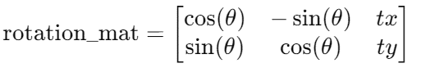
Implementation of Rotation algorithm in Halide:
Implementation of Rotation algorithm in Halide:
Initial parameters:
float rot_angle = 45;
Point2f center(img.cols / 2.0, img.rows / 2.0);
‘rot_angle’ is the rotation angle in degrees.
‘Center’ is the point around which the image will be rotated (the center of the image).
Calculate the Rotation Matrix:
Mat rotation_mat = getRotationMatrix2D(center, rot_angle, 1.0);
getRotationMatrix2D creates a 2x3 rotation matrix for rotating the image around the specified center point.
The scale factor is 1.0, meaning the image size remains unchanged apart from rotation.
Where (𝑡𝑥,𝑡𝑦) are the translation components.
Calculate Bounding Box:
Rect2f bbox = RotatedRect(Point2f(), img.size(), rot_angle).boundingRect2f();
‘RotatedRect’ calculates the rotated rectangle.
‘boundingRect2f’ computes the axis-aligned bounding box that contains the rotated rectangle.

Slide 3
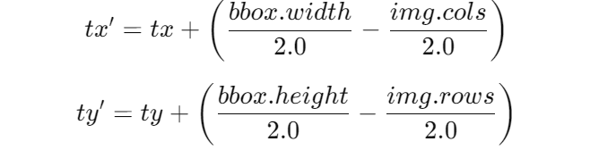
Implementation of Rotation algorithm in Halide:
Implementation of Rotation algorithm in Halide:
Adjust the Transformation Matrix:
rotation_mat.at<double>(0, 2) += bbox.width / 2.0 - img.cols / 2.0;
rotation_mat.at<double>(1, 2) += bbox.height / 2.0 - img.rows / 2.0;
Adjusts the translation components (tx and ty) of the rotation matrix to center the rotated image within the bounding box.
Without this adjustment, the image would not be correctly centered in the new bounding box.
This ensures the rotated image is correctly centered within its new bounding box.
Perform the Affine Transformation:
warpAffine(img, rotated, rotation_mat, bbox.size());
‘warpAffine’ applies the affine transformation to the image using the rotation matrix and outputs the rotated image.
The output image size is set to the bounding box size calculated earlier.

Slide 4
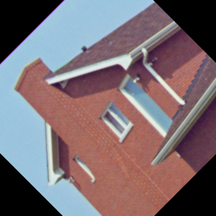
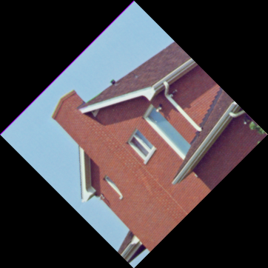
Comparison between user defined function and inbuild function
Comparison:
User defined Functions (affine_transform):
Parameters:-
(org_img, rotated_img, rotation_mat)
Sample Output:
Original dimensions: 256×256 pixels
Image dimensions: 256×256 pixels
In-built Functions (warpAffine):
Parameters:-
(org_img, rotated_img, rotation_mat, bbox.size())
Sample Output:
Original dimensions: 256×256 pixels
Image dimensions: 362×362 pixels

Slide 5
Comparison between user defined function and inbuild function
Comparison:
Drawbacks of User defined Functions (affine_transform):
The corners of the rotated image were trimmed because the bounding box of the rotated image was set to the same size as the original image.
Grayscale images cannot undergo rotation.
Time Comparison Table of Different Images Between User-Defined Affine Transform Function and Built-In Affine Transform Function.
Image source: https://web.archive.org/web/20110526212755/http://sipi.usc.edu/database/database.php?volume=misc
So the user defined function is not better than the existing warpAffine function.
Image |  |  |  |  | Time (sec)
Filename | Description | Size | Type |  | In User Defined | Inbuild (Warp-affine) | Difference
test_img_01 | Girl | 256 X 256 | Color |  | 2.797 | 0.554 | 2.243
test_img_02 | House | 257 X 256 | Color |  | 2.808 | 0.627 | 2.181
test_img_03 | Tree | 258 X 256 | Color |  | 2.763 | 0.593 | 2.17
test_img_04 | Jelly_beans | 259 X 256 | Color |  | 3.323 | 0.564 | 2.759
test_img_05 | Mandrill | 512 X 512 | Color |  | 3.07 | 0.664 | 2.406
test_img_06 | Girl | 513 X 512 | Color |  | 3.049 | 0.501 | 2.548
test_img_07 | Airplane-F16 | 514 X 512 | Color |  | 3.051 | 0.607 | 2.444
test_img_08 | Sailboat | 515 X 512 | Color |  | 2.745 | 0.59 | 2.155
 |  |  | Avg: |  | 2.95075 | 0.5875 | 2.36325

Slide 6
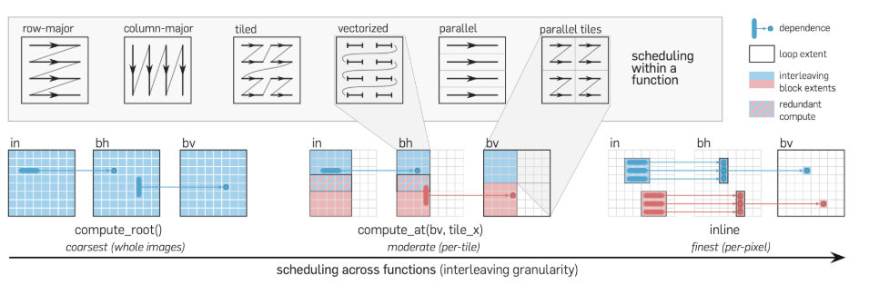
Comparison between Parallel ,vectorized and parallel tiled
• Tile: Tiling, in the context of image processing, refers to dividing a large image into smaller, manageable sections called tiles or blocks. Each tile represents a portion of the original image, typically of equal size.
• vectorize: vectorized scheduling enhances computational throughput by processing multiple data elements in parallel, thereby accelerating the overall execution time.
• parallel: parallelizes computation along the dimension given by the variable.

Slide 7
Comparison between Parallel ,vectorized and parallel tiled
Implemented the affine transformation using three methods: tiling, parallel processing, and vectorization. To evaluate their performance, I compared the following approaches:
Combining all three methods: tiling, parallel processing, and vectorization.
Using only parallel processing.
Using only vectorization.
The results of these comparisons demonstrate the efficiency and effectiveness of each approach.
Reference: https://digitalassets.lib.berkeley.edu/techreports/ucb/incoming/EECS-2023-228.pdf
Image |  |  |  |  | Time (sec)
Filename | Description | Size | Type |  | In User Defined | Inbuild (Warp-Affine) | tile & parallel & vectorize | parallel | vectorize
test_img_01 | Girl | 256 X 256 | Color |  | 2.797 | 0.554 | 2.573 | 3.265 | 2.298
test_img_02 | House | 257 X 256 | Color |  | 2.808 | 0.627 | 2.543 | 3.342 | 2.396
test_img_03 | Tree | 258 X 256 | Color |  | 2.763 | 0.593 | 2.418 | 3.025 | 2.313
test_img_04 | Jelly_beans | 259 X 256 | Color |  | 3.323 | 0.564 | 3.348 | 3.167 | 2.856
test_img_05 | Mandrill | 512 X 512 | Color |  | 3.07 | 0.664 | 3.592 | 3.058 | 2.704
 |  |  | Avg: |  | 2.9522 | 0.6004 | 2.8948 | 3.1714 | 2.5134

Slide 8
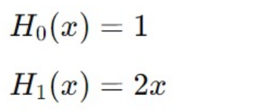

Implementation of Image Rotation Using Hermite Expansions
1st code
Hermite Polynomial Function:
// Base cases
if (n == 0) return Expr(1.0f);
if (n == 1) return 2.0f * x;
// Iterative calculation
Expr h0 = Expr(1.0f);
Expr h1 = 2.0f * x;
Expr h;
for (int i = 2; i <= n; ++i) {
h = 2.0f * x * h1 - 2.0f * (i - 1) * h0;
h0 = h1;
h1 = h;
}
return h1;

Slide 9

Implementation of Image Rotation Using Hermite Expansions
1st code
2. Hermite Expansion of an Image:
RDom r(0, width, 0, height): Define a reduction domain r that spans the entire image. This will be used to iterate over all pixel values in the image.
Sum the Hermite Polynomial Terms:
expansion(n, m) = sum(input(r.x, r.y) * hermite(n, cast<float>(r.x) - cast<float>(width) / 2.0f) * hermite(m, cast<float>(r.y) - cast<float>(height) / 2.0f));
This line computes the Hermite expansion coefficients c_{mn} for each pair (n, m) by summing the product of the input image pixel values input(r.x, r.y) and the Hermite polynomials evaluated at the centered coordinates (r.x - width/2) and (r.y - height/2).
The formula for computing the Hermite expansion coefficients Cmn​ in a discrete image is:
Note: Here typecasting error arises in n,m in this equation.

Slide 10
Implementation of Image Rotation Using Hermite Expansions
1st code
3. Rotate hermite:
int n, m;
Func rotated("rotated");
float angle_radians = angle * (float)M_PI / 180.0f;
float cos_theta = cos(angle_radians);
float sin_theta = sin(angle_radians);
rotated(n, m) = 0.0f;
for (int k = 0; k <= order; ++k) {
for (int l = 0; l <= order; ++l) {
rotated(n, m) += coeffs(k, l) *
cos_theta * hermite(n, k) *
sin_theta * hermite(m, l);
}
}
return rotated;
4. Reconstruct image:
Var x("x"), y("y"), c("c");
Func reconstructed("reconstructed");
Expr xc = cast<float>(x) - cast<float>(width) / 2.0f;
Expr yc = cast<float>(y) - cast<float>(height) / 2.0f;
RDom r(0, order + 1, 0, order + 1); // Iterate from 0 to order
reconstructed(x, y, c) = 0.0f;
for (int n = 0; n <= order; ++n) {
for (int m = 0; m <= order; ++m) {
reconstructed(x, y, c) += coeffs(n, m, c) *
hermite(n, xc) *
hermite(m, yc);
}
}
return reconstructed;

Slide 11

Implementation of Image Rotation Using Hermite Expansions
2nd Code
Hermite Polynomial Function:
Expr hermite(Expr n, Expr x) {
// Base cases
Expr h0 = Expr(1.0f);
Expr h1 = 2.0f * x;
Expr h = select(n == 0, h0,
n == 1, h1,
Expr());
// Iterative calculation
for (int i = 2; i <= 10; ++i) { // Limit the loop to a maximum of 10 to prevent infinite loops
h = select(n == i, 2.0f * x * h1 - 2.0f * (i - 1) * h0, h);
h0 = select(n == i, h1, h0);
h1 = select(n == i, h, h1);
}
return h;
}
2. Hermite Expansion of an Image:
// No change from 1st code.
3. Rotate hermite:
changed these variables from int to Var.
Var n("n"), m("m"), c("c");
4. Reconstruct image:
// No change from 1st code.
Error: Segmentation fault.
Possible reason :- Accessing out-of-bounds memory. As no clamp is used.

Slide 12
Implementation of Image Rotation Using Hermite Expansions
3rd Code
Hermite Polynomial Function:
Func hermite_function(int n, Expr x) {
Func H("H" + std::to_string(n)); Var t("t");
if (n == 0) {
H(t) = 1.0f;
} else if (n == 1) {
H(t) = 2.0f * t;
} else {
Func Hn_1 = hermite_function(n - 1, x);
Func Hn_2 = hermite_function(n - 2, x);
H(t) = 2.0f * t * Hn_1(t) - 2.0f * (n - 1) * Hn_2(t);
}
H.compute_root
return H;
}
2. Hermite Expansion of an Image:
Func hermite_expansion(Func image, int max_order, Expr rows, Expr cols, Expr channels) {
Var n("n"), m("m"), c("c");
Func coeffs("coeffs");
coeffs(n, m, c) = 0.0f;
RDom r(0, rows, 0, cols, 0, channels);
for (int n = 0; n < max_order; n++) {
for (int m = 0; m < max_order; m++) {
Func Hn = hermite_function(n, cast<float>(r.x) / (rows / 2.0f) - 1.0f);
Func Hm = hermite_function(m, cast<float>(r.y) / (cols / 2.0f) - 1.0f);
coeffs(n, m, r.z) += image(r.x, r.y, r.z) * Hn(r.x) * Hm(r.y);
}
}
return coeffs;
}

Slide 13
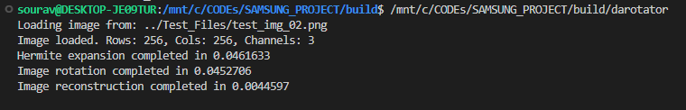
Implementation of Image Rotation Using Hermite Expansions
3rd Code
4. Reconstruct image: No changes from previous code.
3. Rotate hermite:
Func rotate_image(Func coeffs, float angle, int max_order, Expr channels) {
Var n("n"), m("m"), c("c");
Func rotated_coeffs("rotated_coeffs");
// Calculate the rotation matrix elements
float angle_radians = angle * static_cast<float>(M_PI) / 180.0f;
Expr cos_angle = cos(angle_radians);
Expr sin_angle = sin(angle_radians);
// Initialize rotated_coeffs to zero
rotated_coeffs(n, m, c) = 0.0f;
RDom r(0, max_order, 0, max_order, 0, channels);
Expr new_n = cast<int>(round(cos_angle * r.x - sin_angle * r.y));
Expr new_m = cast<int>(round(sin_angle * r.x + cos_angle * r.y));
rotated_coeffs(clamp(new_n, 0, max_order - 1), clamp(new_m, 0, max_order - 1), r.z) += coeffs(r.x, r.y, r.z);
return rotated_coeffs;
Problem: The Execution of code is stuck in the realize function of the halide.

Slide 14
Implementation of Image Rotation Using Hermite Expansions
4th Code using cpp and OpenCV.
1. Hermite:
double hermite(int n, double x) {
if (n == 0) return 1.0;
if (n == 1) return 2.0 * x;
return 2.0 * x * hermite(n - 1, x) - 2.0 * (n - 1) * hermite(n - 2, x);
}
2. HermiteExpansion:
std::vector<std::vector<double>> hermiteExpansion(const cv::Mat& channel, int order) {
int rows = channel.rows; int cols = channel.cols;
std::vector<std::vector<double>> coeffs(order, std::vector<double>(order, 0.0));
for (int m = 0; m < order; ++m) {
for (int n = 0; n < order; ++n) {
double sum = 0.0;
for (int i = 0; i < rows; ++i) {
for (int j = 0; j < cols; ++j) {
double x = (2.0 * i / rows) - 1.0;
double y = (2.0 * j / cols) - 1.0;
sum += static_cast<double>(channel.at<uchar>(i, j)) * hermite(m, x) * hermite(n, y);
}
}
coeffs[m][n] = sum / (rows * cols); // Normalizing by the number of pixels
}
}
return coeffs;
}

Slide 15
Implementation of Image Rotation Using Hermite Expansions
4th Code using cpp and OpenCV.
3. RotateChannelUsingHermite:
cv::Mat rotateChannelUsingHermite(const cv::Mat& channel, double angle, int order) {
int rows = channel.rows;
int cols = channel.cols;
cv::Mat rotatedChannel(rows, cols, CV_64F, cv::Scalar(0.0));
double cosTheta = std::cos(angle);
double sinTheta = std::sin(angle);
for (int i = 0; i < rows; ++i) {
for (int j = 0; j < cols; ++j) {
double x = (2.0 * i / rows) - 1.0;
double y = (2.0 * j / cols) - 1.0;
double newX = cosTheta * x - sinTheta * y;
double newY = sinTheta * x + cosTheta * y;
// Convert newX, newY back to image pixel coordinates
int newI = static_cast<int>((newX + 1.0) * rows / 2.0);
int newJ = static_cast<int>((newY + 1.0) * cols / 2.0);
if (newI >= 0 && newI < rows && newJ >= 0 && newJ < cols) {
rotatedChannel.at<double>(newI, newJ) += static_cast<double>(channel.at<uchar>(i, j));
}
}
}
// Normalize the channel to the range [0, 255]
double minVal, maxVal;
cv::minMaxLoc(rotatedChannel, &minVal, &maxVal);
rotatedChannel.convertTo(rotatedChannel, CV_8UC1, 255.0 / (maxVal - minVal), -minVal * 255.0 / (maxVal - minVal));
return rotatedChannel;
}

Slide 16
Implementation of Image Rotation Using Hermite Expansions
4th Code using cpp and OpenCV.
4. RotateImageUsingHermite:
cv::Mat rotateImageUsingHermite(const cv::Mat& image, double angle, int order) {
std::vector<cv::Mat> channels;
cv::split(image, channels);
std::vector<cv::Mat> rotatedChannels(3);
for (int c = 0; c < 3; ++c) {
rotatedChannels[c] = rotateChannelUsingHermite(channels[c], angle, order);
}
cv::Mat rotatedImage;
cv::merge(rotatedChannels, rotatedImage);
return rotatedImage;
}

Slide 17
Implementation of Image Rotation Using Bresenham line algorithm
1st Code using cpp and OpenCV.
std::vector<cv::Point> bresenhamLine(int x0, int y0, int x1, int y1) {
std::vector<cv::Point> points;
int dx = std::abs(x1 - x0);
int dy = std::abs(y1 - y0);
int sx = (x0 < x1) ? 1 : -1;
int sy = (y0 < y1) ? 1 : -1;
int err = dx - dy;
while (true) {
points.push_back(cv::Point(x0, y0));
if (x0 == x1 && y0 == y1) break;
int e2 = 2 * err;
if (e2 > -dy) {
err -= dy;
x0 += sx;
}
if (e2 < dx) {
err += dx;
y0 += sy;
}
}
return points;
}
Explanation:
points: A vector to store the points on the line.
dx: The absolute difference between the x-coordinates of the two points.
dy: The absolute difference between the y-coordinates of the two points.
sx: The sign of the x increment. If x0 is less than x1, sx is 1; otherwise, it is -1.
sy: The sign of the y increment. If y0 is less than y1, sy is 1; otherwise, it is -1.
err: The error term, initially set to dx - dy.
Detailed Steps in Each Iteration
Current Point: Add the current point (x0, y0) to the points vector.
Check End Condition: If the current point matches the end point, break out of the loop.
Double the Error Term: Calculate e2 as 2 * err.
Adjust X: If e2 > -dy, adjust the error term by subtracting dy and move x0 by sx.
Adjust Y: If e2 < dx, adjust the error term by adding dx and move y0 by sy.

Slide 18
Implementation of Image Rotation Using Bresenham line algorithm
1st Code using cpp and OpenCV.
cv::Mat rotateImage(const cv::Mat& image, double angle) {
int h = image.rows;
int w = image.cols;
double dc = std::cos(angle * CV_PI / 180.0);
double ds = std::sin(angle * CV_PI / 180.0);
// Calculate dimensions of the new image
int h_new = static_cast<int>(std::abs(h * dc) + std::abs(w * ds));
int w_new = static_cast<int>(std::abs(h * ds) + std::abs(w * dc));
cv::Mat rotatedImage = cv::Mat::zeros(h_new, w_new, image.type());
int cx = w / 2;
int cy = h / 2;
int cx_new = w_new / 2;
int cy_new = h_new / 2;
for (int y = 0; y < h; ++y) {
auto line = bresenhamLine(0, y, w - 1, y); // Get points of the line using Bresenham's algorithm
for (const auto& point : line) {
int x = point.x;
int y = point.y;
int x_new = static_cast<int>((x - cx) * dc - (y - cy) * ds + cx_new);
int y_new = static_cast<int>((x - cx) * ds + (y - cy) * dc + cy_new);
if (x_new >= 0 && x_new < w_new && y_new >= 0 && y_new < h_new) {
rotatedImage.at<cv::Vec3b>(y_new, x_new) = image.at<cv::Vec3b>(y, x);
}
}
}

Slide 19
Implementation of Image Rotation Using Warp Affine
Load Input Image: Load the input image using OpenCV’s imread function. Check if the image data is loaded successfully.
Set Rotation Angle and Center: Define the rotation angle.
Calculate the center of the image.
Calculate Rotation Matrix: Use OpenCV’s getRotationMatrix2D to get the rotation matrix.
Calculate Bounding Box for Rotated Image: Use OpenCV’s RotatedRect to calculate the size of the bounding box that can contain the rotated image.
Adjust the Transformation Matrix: Adjust the rotation matrix to account for the translation required to keep the image centered.
Perform the Affine Transformation (Rotation):Use OpenCV’s warpAffine to perform the rotation with bilinear interpolation.
Save the Rotated Image: Save the rotated image using OpenCV’s imwrite function.
Limitation : It uses floating point multiplications in the loops so it takes more time.

Slide 20
Implementation of Image Rotation Using DLR
Compute Rotation Parameters: Normalize the rotation angle to the range [0, 360) degrees. Convert the angle to radians.
Compute trigonometric values (sin_alpha, cos_alpha, tan_alpha, tan_alpha_).
Calculate Output Image Size: Determine the dimensions of the rotated image matrix (mrt, nrt).
Initialize the Rotated Image Matrix: Create an empty matrix (rot) with the computed dimensions and the same type as the input image.
Determine Rotation Zone and Set Parameters: Based on the angle, determine which zone (1-8) the angle falls into.
Set parameters such as offsets, function for x value (fs), deltas, and loop limits accordingly.
Perform Rotation Using the rotate Function: The rotate function is called with the appropriate parameters.
Use OpenMP for parallel processing to speed up the computations.
Iterate through each pixel in the source image, computing the corresponding destination coordinates in the rotated image.
Advantage : It uses floating point multiplications once while calculating the trigonometric values and in the loops it performs simple arithmetic additions.

Slide 21
Thank you

